Slide 1
First class social work: building professional capability and confidence
Walsall – July 8th 2015
Annie Hudson – Chief Executive
The College of Social Work

Slide 2
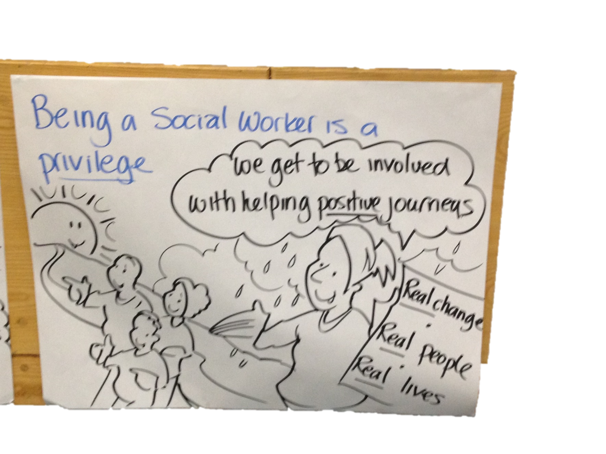

Slide 3
Focus today:
Social work: its problems, peculiarities and power
Confidence – own agency not ‘victims’
Capability – fallibility, analysis, authority and the ‘right’ conditions
Capacity – professional leadership

Slide 4
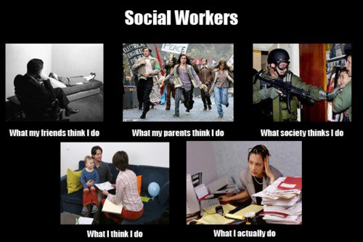

Slide 5
1- The ‘problem’ and pecularities of social work
About:
Professional status and standing:
Practice evidence and outcomes: elusive/2nd hand
Voice(s) diffuse and not strong
Role + identity: invisible yet public
Risk, dysfunction and ‘defence systems’ (Menzies)
Consequences: public narratives, morale, retention
Wider landscapes – austerity, politics, leadership

Slide 6
2 – Building professional confidence and pride
What it means to be a ‘professional’
Rebalance: agency vs professional role
Renaissance of ‘real’ social work vs ambivalence
Not ‘victims’ ….greater responsibility + control
Clear what do + value
One profession: generic vs specialist expertise (PCF + KSS)
Notes:
TCSW work
Difficult – professional values and public ambivalence – source of so much consternation
Roles and Functions – complexity, ambiguity

Slide 7
3- Building capability for first class practice
Rediscovering what we are about ….
‘Best in class’ relationship ‘experts’ – why, what + how
‘Wide’ lens’ …..joining up elements of lives
Developing models: reflection, evidence.
More on…..
Authority, analysis, risk + systems fallibility
Conditions for first class practice

Slide 8
Authority
Agency, professional + personal – multiplier effects
Evidence: direction, clarity, communication, impact
Nuancing and utilising in ‘best interests’
Changing expectations – children and adult services’
Notes:
Sources and manifestations – agency/positional vs professional and personal (multiplier effect ….. ‘thou shalt do’.
Skills in utilising – creating change
How evidence and observe – setting direction, be open/unambiguous, communication

Slide 9
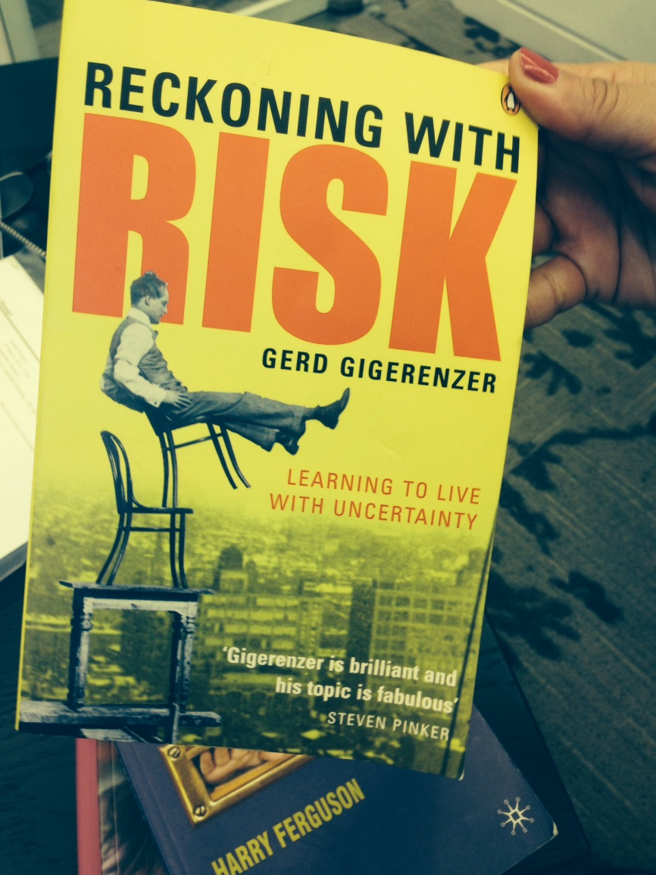
Analysis and risk
‘Clouded thinking’
Changing opinions
Decision making in
context of uncertainty
Supervision
Notes:
‘Clouded thinking’ – i.e know risks but not able to draw conclusions or inferences …… can be paralysed – (alternatively may be either ignorant of or miscommunicate risks to others)
Changing opinions - Decisions making in context of uncertainty… - always there but need to articulate what doing, why, and how….
Analysing information –recording it – tools, competences, triangulation (work of Danielle Turvey in Bristol – looking at supervision)
Supervision – cognitive and affective /emotional dimensions – how evidence…. Means to end (getting reskilled again?) -

Slide 10
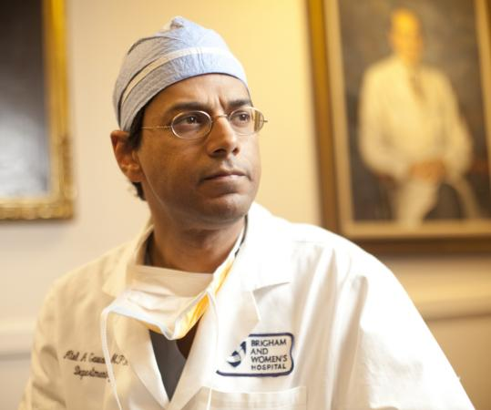
Fallibility and what we do well
Systems… are messier than we knew …and wanted to know (Reith Lectures
BBC R4 2014)
Atal Gawande:
Ignorance
Ineptitude
Infallibility
…. ‘Fear of looking’: skilled + challenging ‘inquirers

Slide 11
‘Roses don’t grow in concrete’ (Munro 2015) - Conditions for first class practice:
Risk conscious not averse
‘Emotionally informed thinking spaces’ (Ferguson) – quality of supervision
Grit in the system: constructive challenge, QA
Accreditation, assessment and CPD
LGA standards + ‘organisational health’ checks

Slide 12
4–Capacity through system leadership + voice
What doctors can teach us!
SW’s new ‘architecture’: CSW, PSW but ‘demise’ of TCSW.
Whither resources and functions….. ?
Authoritative, inquisitive+ challenging
Leadership : everyone’s responsibility

Slide 13
Concluding thoughts
Confident and capable – via quality, leadership + responsibility
Clarity about what, how and why: ‘skilled and challenging inquirers’
Strong and distinctive voice – pride and learning

